Slide 1
R
Correlation and Covariance

Slide 2
Correlation Test Between Two Variables
Correlation test is used to evaluate the association between two or more variables.
For instance, if we are interested to know whether there is a relationship between the heights of fathers and sons, a correlation coefficient can be calculated to answer this question.

Slide 3
install.packages("ggpubr") for graphs

Slide 4
Methods for correlation analyses
There are different methods to perform correlation analysis:
Pearson correlation (r), which measures a linear dependence between two variables (x and y). It’s also known as a parametric correlation test because it depends to the distribution of the data. It can be used only when x and y are from normal distribution. The plot of y = f(x) is named the linear regression curve.
Kendall tau and Spearman rho, which are rank-based correlation coefficients (non-parametric)

Slide 5
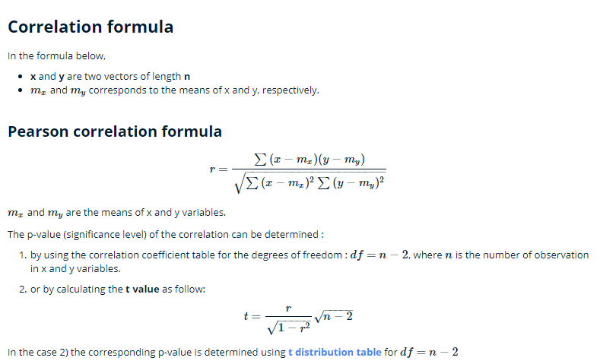
Correlation formula

Slide 6
If the p-value is < 5%, then the correlation between x and y is significant.

Slide 7
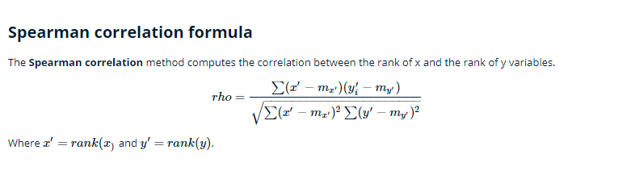
Rank - spearman

Slide 8
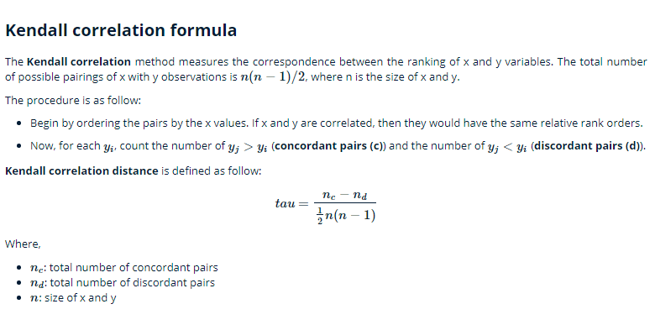

Slide 9
R
cor() computes the correlation coefficient
cor.test() test for association/correlation between paired samples. It returns both the correlation coefficient and the significance level(or p-value) of the correlation .

Slide 10
cor(x, y, method = c("pearson", "kendall", "spearman"))
cor.test(x, y, method=c("pearson", "kendall", "spearman"))
x, y: numeric vectors with the same length
method: correlation method

Slide 11
Before Correlation analysis – visualize / inspect data
If your data contain missing values, use the following R code to handle missing values by case-wise deletion.
cor(x, y, method = "pearson", use = "complete.obs")

Slide 12
Before CORR – visualize / inspect data

Slide 13
Correlation R code
print(str(mtcars))
print(str(mtcars)) print(head(mtcars))
## MPG - Miles per gallon (litlre)
## Wt - Weight
corrout <- cor.test(mtcars$mpg, mtcars$wt, method=c("pearson"), use = "complete.obs", na.rm = TRUE)
print(corrout)

Slide 14
Pearson's product-moment correlation
data: mtcars$mpg and mtcars$wt
t = -9.559, df = 30, p-value = 1.294e-10
alternative hypothesis: true correlation is not equal to 0
95 percent confidence interval:
-0.9338264 -0.7440872
sample estimates:
cor
-0.8676594

Slide 15
What is a Bivariate (Pearson) Correlation?
Correlation generally describes the effect that two or more phenomena occur together and therefore they are linked.
is the time and intensity of exposure to sunlight related the likelihood of getting skin cancer?
It is very important, however, to stress that correlation does not imply causation.

Slide 16
A correlation expresses the strength of linkage or co-occurrence between to variables in a single value
between -1 and +1.
This value that measures the strength of linkage is called correlation coefficient, which is represented typically as the letter r.

Slide 17
Postive Correlation : If A Increases, B increases
Negative Correlation: If A Increases, B decreases. Inversely proportional.
The correlation coefficient between two continuous-level variables is also called Pearson’s r or Pearson product-moment correlation coefficient.
Eg: -0.8676594
Negative, 0.86
Negative and Very strong

Slide 18
Strength Between 0 to 1. Low/Moderate/High
Direction = Positive or Negative

Slide 19
is correlation coefficient is significant?
P-value ≤ α: The correlation is statistically significant
If the p-value is less than or equal to the significance level, then you can conclude that the correlation is different from 0. Means Correlation exists.
Usually, a significance level (denoted as α or alpha) of 0.05 works well.
p-value = 1.294e-10 : 10 th power minus 0.000012 like this !!

Slide 20
P-value > α: The correlation is not statistically significant
If the p-value is greater than the significance level, then you cannot conclude that the correlation is different from 0.
P above 0.05 means, no correlation

Slide 21
Spearman
In a monotonic relationship, the variables tend to move in the same relative direction, but not necessarily at a constant rate

Slide 22
Question?
Pearson's product-moment correlation
data: A.C$Average.tortuosity and A.C$Area
t = -0.6168, df = 14, p-value = 0.5473
alternative hypothesis: true correlation is not equal to 0
95 percent confidence interval:
-0.6092369 0.3622606
sample estimates:
cor
-0.1626531

Slide 23
H0: There is no significant relationship between A and B.
Ha: There is a statistically significant relationship A and B
Because p < .05, reject the null of no relationship and conclude that the relationship is statistically significant.

Slide 24
Correlation coefficient – r –rho
T-test
t-test for testing H0: β1= 0
ANOVA F-test for testing H0: β1= 0

Slide 25
T-test
The output tells us that the probability of getting a test-statistic smaller than 9.5 is greater than 0.999. Therefore, the probability of getting a test-statistic greater than 9.5is less than 0.00
When it is not obvious which variable is the response.
The (x, y) pairs are independent

Slide 26
95 percent confidence interval meaning
A confidence interval does not quantify variability
A 95% confidence interval is a range of values that you can be 95% certain contains the true mean of the population. This is not the same as a range that contains 95% of the values. The graph below emphasizes this distinction.

Slide 27
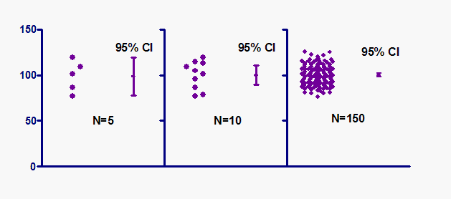
The graph shows three samples (of different size) all sampled from the same population.
confidence interval is quite narrow when computed from a large sample. (N = 150)

Slide 28
NOTE:
Don't view a confidence interval and misinterpret it as the range that contains 95% of the values.

Slide 29
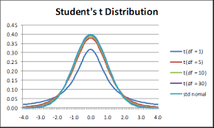
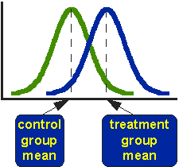
T Test (Student’s T-Test): is by Chance? Real?

Slide 30
Control = 5 Years, Drug = 6 Years
Student’s T-tests can be used in real life to compare means. For example, a drug company may want to test a new cancer drug to find out if it improves life expectancy. In an experiment, there’s always a control group (a group who are given a placebo, or “sugar pill”). The control group may show an average life expectancy of +5 years, while the group taking the new drug might have a life expectancy of +6 years. It would seem that the drug might work. But it could be due to a fluke.
To test this, researchers would use a Student’s t-test to find out if the results are repeatable for an entire population.

Slide 31
The t test (also called Student’s T Test) compares two averages (means) and tells you if they are different from each other. The t test also tells you how significant the differences are; In other words it lets you know if those differences could have happened by chance.

Slide 32
The t score is a ratio between the difference between two groups and the difference within the groups.
The larger the t score, the more difference there is between groups. The smaller the t score, the more similarity there is between group
A t score of 3 means that the groups are three times as different from each other as they are within each other. When you run a t test, the bigger the t-value, the more likely it is that the results are repeatable.s.

Slide 33
A large t-score tells you that the groups are different.
A small t-score tells you that the groups are similar

Slide 34
a p-value of .01 means there is only a 1% probability that the results from an experiment happened by chance. In most cases, a p-value of 0.05 (5%) is accepted to mean the data is valid.

Slide 35
There are three main types of t-test:
An Independent Samples t-test compares the means for two groups.
A Paired sample t-test compares means from the same group at different times (say, one year apart).
A One sample t-test tests the mean of a single group against a known mean.

Slide 36
T Value. Negative sign
Note: You can ignore the minus sign when comparing the two t-values, as ± indicates the direction; the p-value remains the same for both directions.

Slide 37
Ecommerce data
Pearson's product-moment correlation
data: df2018$price and df2018$deal_probability
t = -1.3066, df = 1418100, p-value = 0.1913
alternative hypothesis: true correlation is not equal to 0
95 percent confidence interval:
-0.0027431253 0.0005486488
sample estimates:
cor
-0.001097241

Slide 38
Ecommerce data
Pearson's product-moment correlation
data: df2018b$price and df2018b$deal_probability
t = 86.734, df = 1268400, p-value < 2.2e-16
alternative hypothesis: true correlation is not equal to 0
95 percent confidence interval:
0.07505489 0.07851493
sample estimates:
cor
0.07678514

Slide 39
PLOTS - Visual

Slide 40
library(ggplot2)
qplot(wt, mpg, data = mtcars, colour = wt, geom = "point", ylab = "Miles per Gallon", xlab = "weight", main = "Impact of Number of Weight on MPG")
# check with cyl vs mpg

Slide 41
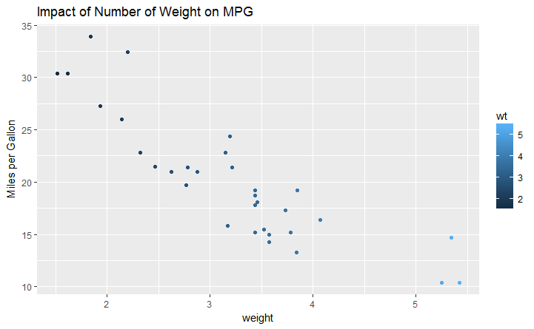
Scatter Plot

Slide 42
## Fittling line ggplot(mtcars, aes(wt, mpg)) + geom_point() + geom_smooth(method = "lm", se = FALSE) + ylab("Miles per Gallon") + xlab("Weight") + ggtitle("Impact of Weight on MPG")

Slide 43
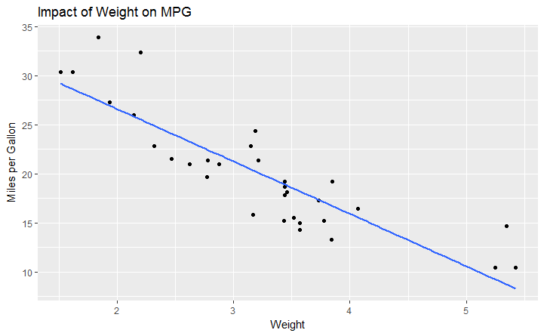
Scatter with line- Regression

Slide 44
ggplot(mtcars, aes(wt, mpg)) + stat_smooth() + geom_point() + ylab("Miles per Gallon") + xlab ("Weight") + ggtitle("Impact of Weight on MPG")

Slide 45
